Slide 1
Decoding TC Tracks
BUFR Data

Slide 2


What is a BUFR file?
“Binary Universal Form for the Representation of meteorological data”
WMO standard format that is table-driven code forms
Binary format; data is packed to increase storage efficiency
Coding standards:
BUFR edition 3
BUFR edition 4
BUFR
message 1
BUFR
message 2
BUFR
message 3
⋯
BUFR
file
BUFR
message n
Notes:
<a href="https://www.flaticon.com/free-icons/email" title="email icons">Email icons created by Freepik - Flaticon</a>
<a href="https://www.flaticon.com/free-icons/folder" title="folder icons">Folder icons created by Freepik - Flaticon</a>

Slide 3
BUFR Message
Section Number | Name | Contents
0 | Indicator | "BUFR", length of message, BUFRedition number
1 | Identification | Length of section, reference tables, initial date
2 | Optional local | Length of section, grid geometry, as necessary
3 | Data description | Length of section; number of subsets
4 | Binary data | Length of section and data values per subset
5 | End section | 7777
BUFR messages are composed of sections. The sections encode the metadata as well as the data itself.
Sections 0, 1 and 5 contain static metadata, mostly for message identification.
Section 2 is optional; if used, it may contain arbitrary data in any form wished for by the creator of the message (this is only advisable for local use).
Section 3 contains a sequence of so-called descriptors that define the form and contents of the BUFR data product.
Section 4 is a bit-stream containing the message's core data values as laid out by Section 3
sections of BUFR message
Notes:
https://confluence.ecmwf.int/display/UDOC/BUFR+structure+-+ecCodes+BUFR+FAQ

Slide 4
ECMWF TC BUFR Data
10-day track forecasts
TCC{YYmmddHH}₀{YYmmddHH}₁1
Tracks from identified TCs in HRES
TCT{YYmmddHH}₀{YYmmddHH}₁1
Tracks from identified TCs in ENS
ENS Member | Description
1 to 50 | Perturbed forecast
51 | Control LRES forecast
52 | Control HRES forecast

Slide 5
Sequential data of storm
name
ensemble number & type
location of TC center in analysis
forecast information
time displacement
location of TC center in member
PRMSL
location of max winds
10-m max wind
radius of winds above specific thresholds per quadrant
18
26
33
<<<<<< section 0 >>>>>>
<<<<<< section 1 >>>>>>
master_table_version
<<<<<< section 2 >>>>>>
<<<<<< section 3 >>>>>>
n_subsets
<<<<<< section 4 >>>>>>
###### subset 1 of 52 ######
…
###### subset 52 of 52 ######
<<<<<< section 5 >>>>>>

Slide 6
pybufrkit

Slide 7
pybufrkit
PyBufrKit is a pure Python package to work with WMO BUFR (FM-94) messages. It can be used as both a command line tool or library to decode and encode BUFR messages. Here is a brief list of some of the features:
Pure Python
Handles both compressed and uncompressed messages
Handles all practical operator descriptors, including data quality info, stats, bitmaps, etc.
Option to construct hierarchical structure of a message, e.g. associate first order stats data to their owners.
Convenient subsetting support for BUFR messages
Comprehensive query support for BUFR messages
Script support enables flexible extensions, e.g. filtering through large number of files.
Tested with the same set of BUFR files used by ecCodes and BUFRDC.

Slide 8
pybufrkit
Command line use of pybufrkit:
pybufrkit [OPTIONS] [command]
where command is one of the following actions:
decode | Decode a BUFR file to outputs of various format, e.g. JSON
encode | Encode a BUFR file from a JSON input
info | Decode only the metadata sections (0, 1, 2, 3) of given BUFR files
split | Split given BUFR files into one message per file
subset | Subset the given BUFR file and save as new file
query | Query metadata or data of given BUFR files
script | Embed BUFR query expressions into normal Python script
lookup | Look up information about the given list of comma separated BUFR descriptors
compile | Compile the given comma separated BUFR descriptors

Slide 9
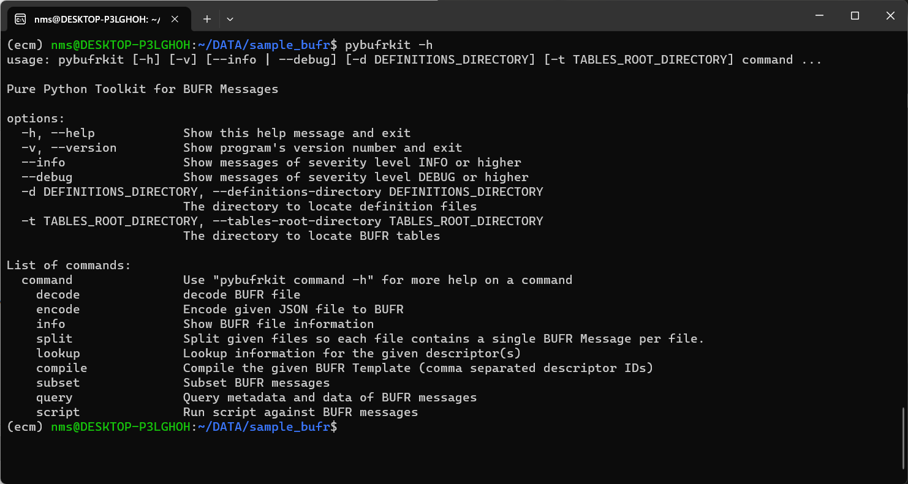
pybufrkit options

Slide 10
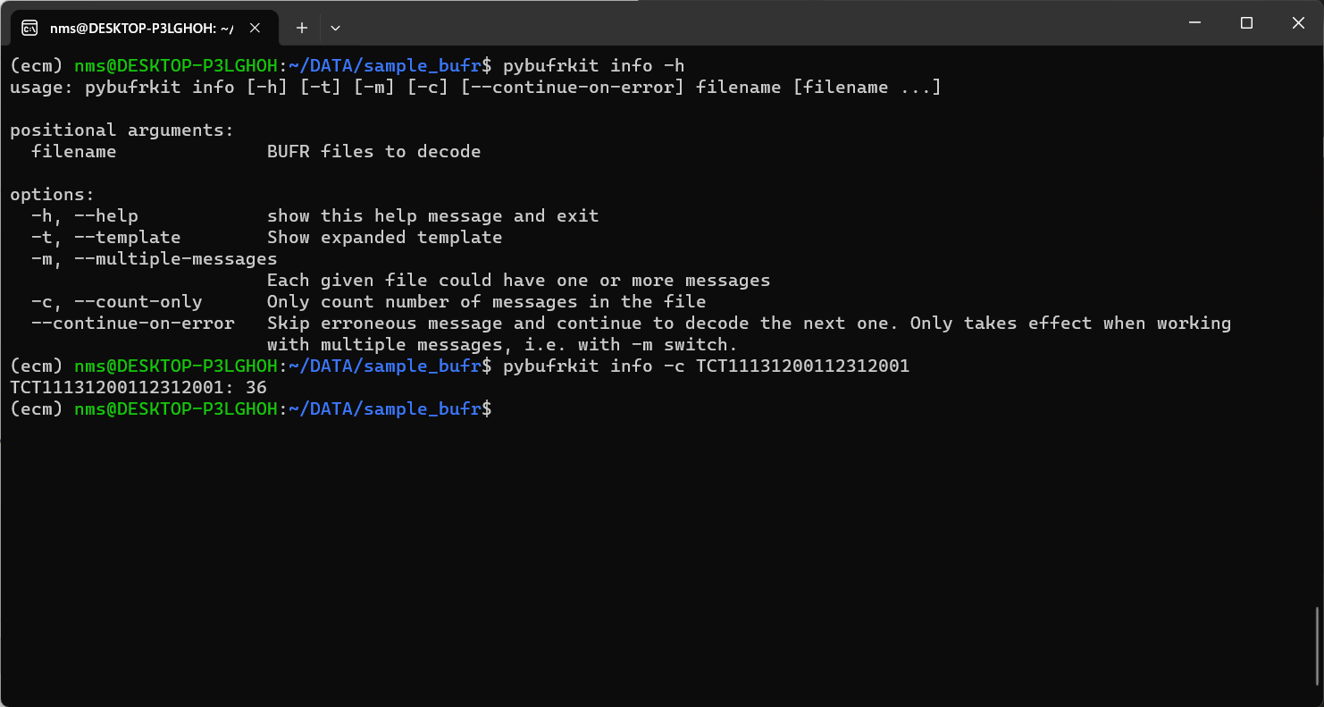
pybufrkit options | info

Slide 11
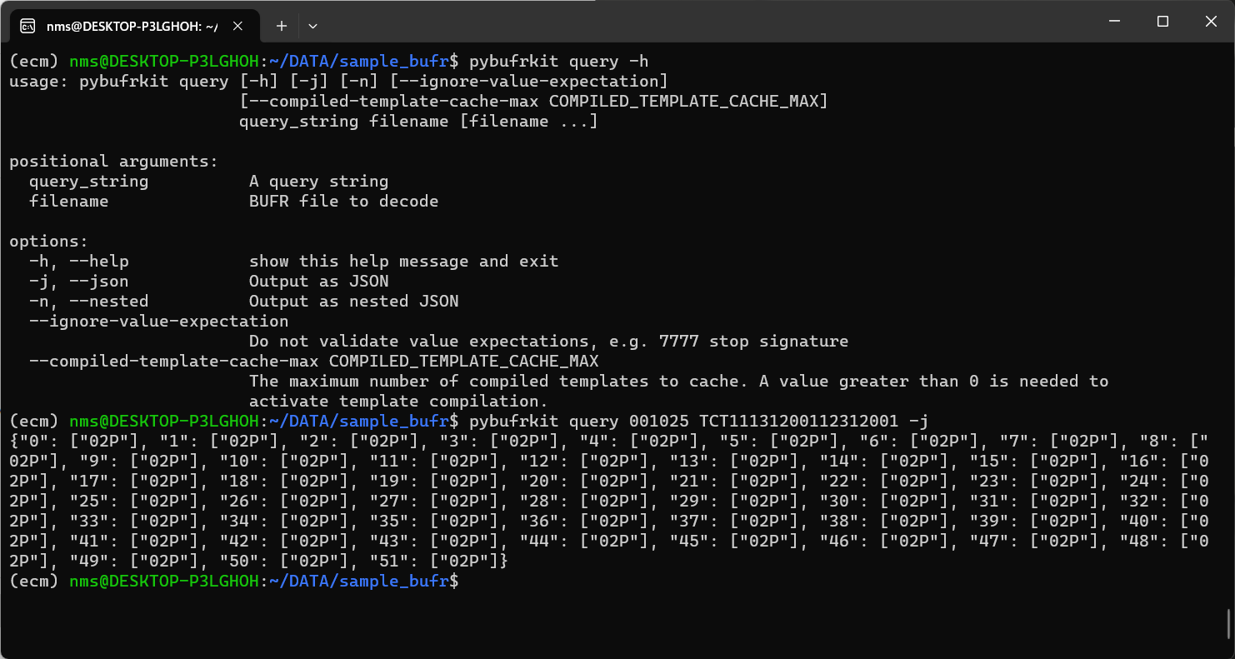
pybufrkit options | query

Slide 12
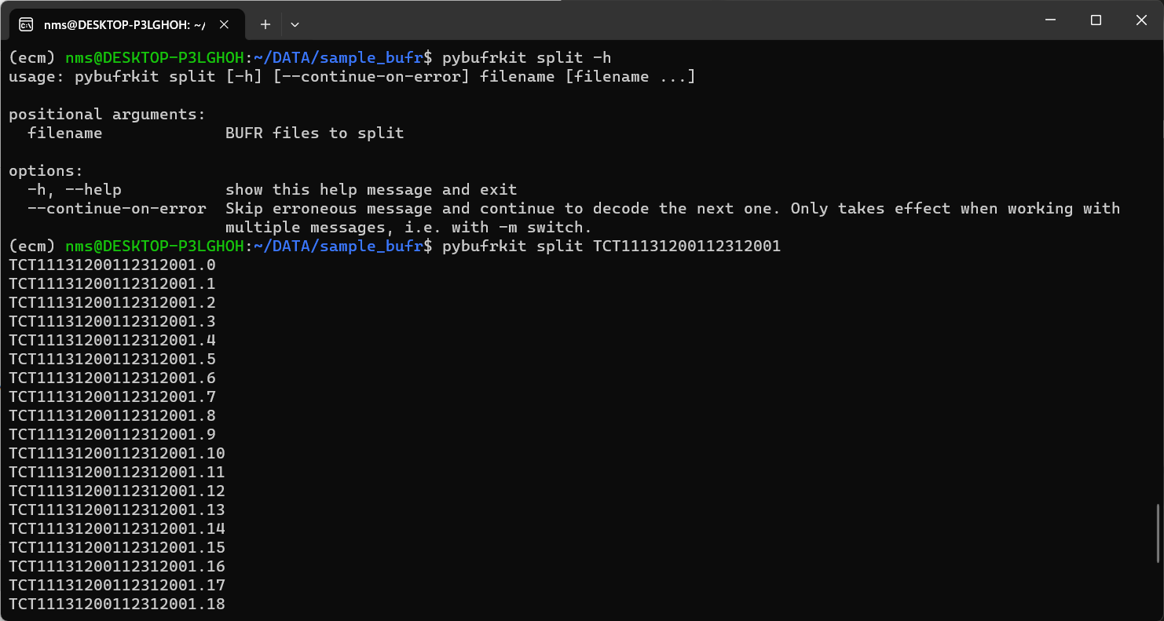
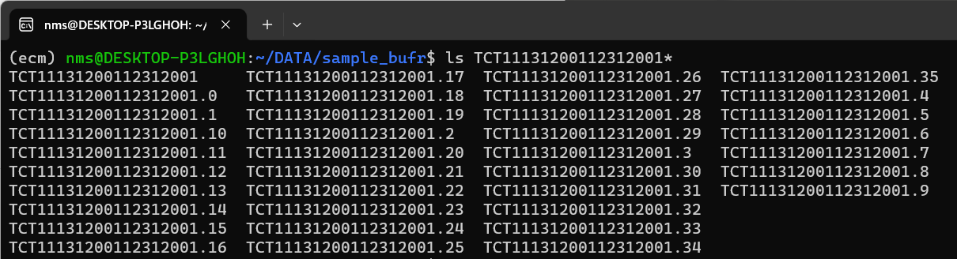
pybufrkit options | split

Slide 13
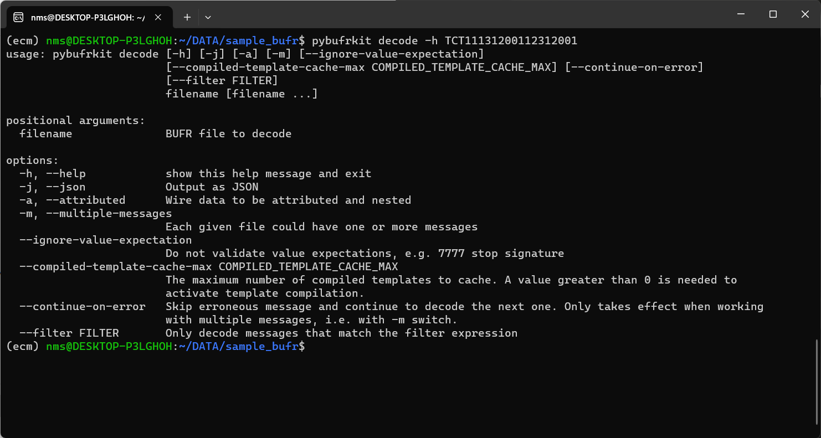
pybufrkit options | decode

Slide 14
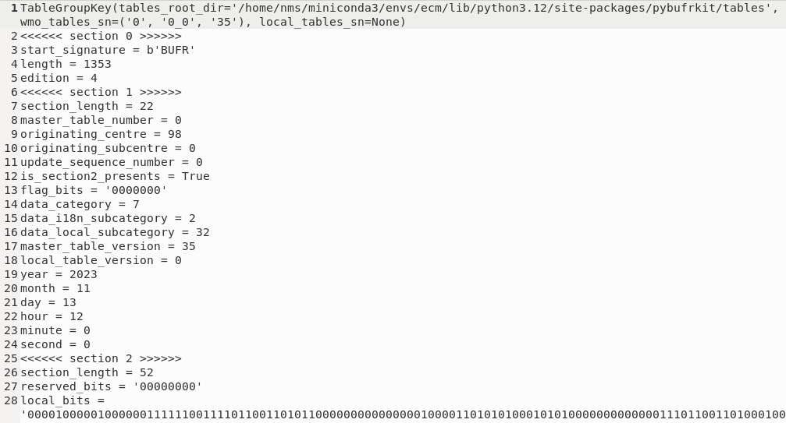
pybufrkit | decode
Section Number | Name | Contents
0 | Indicator | "BUFR", length of message, BUFRedition number
1 | Identification | Length of section, reference tables, initial date
2 | Optional local | Length of section, grid geometry, as necessary

Slide 15
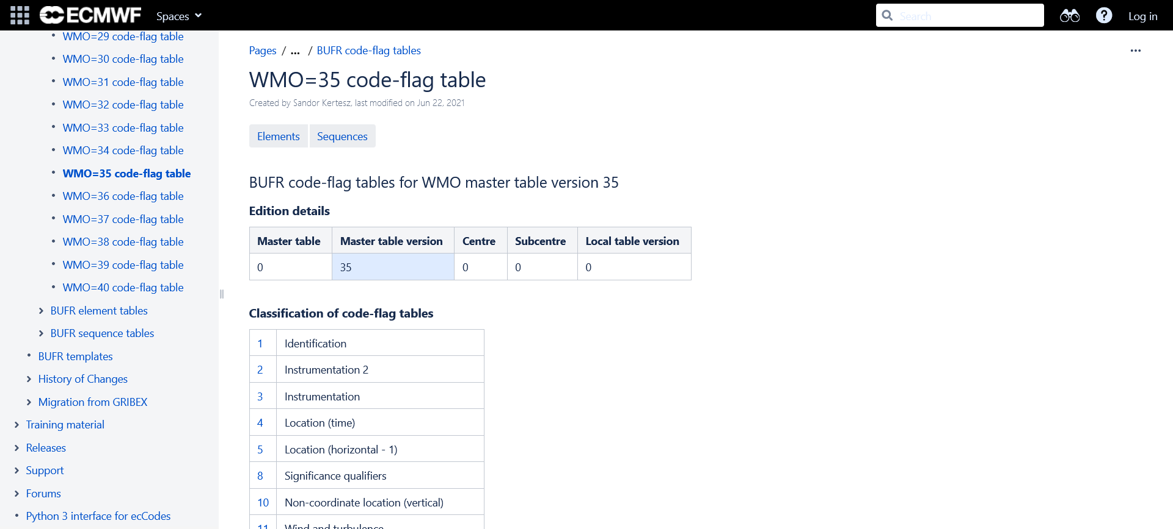
BUFR code-flag tables for WMO master table version 35

Slide 16
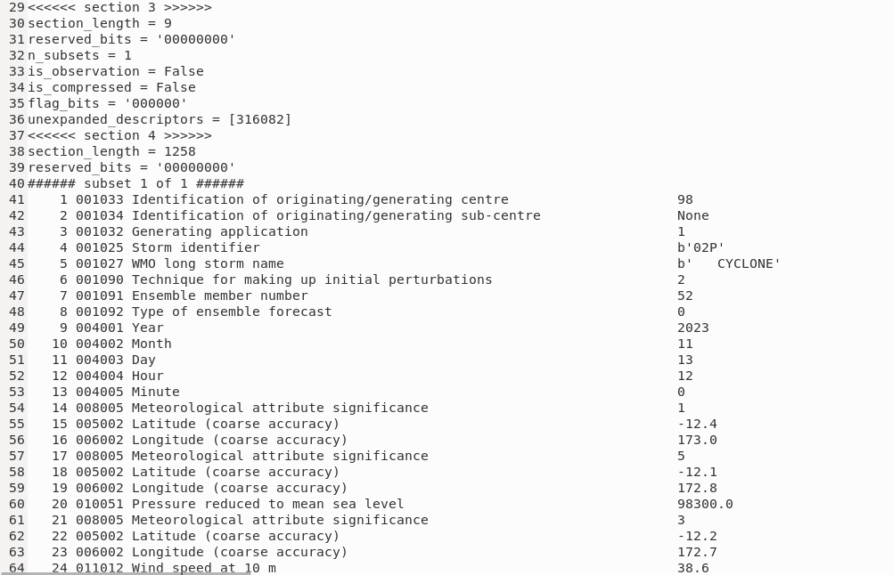
pybufrkit | decode
Section Number | Name | Contents
3 | Data description | Length of section; number of subsets
4 | Binary data | Length of section and data values per subset

Slide 17
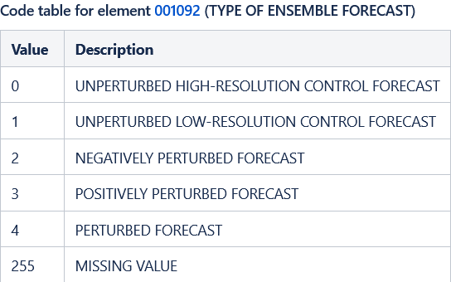
pybufrkit | decode

Slide 18
pybufrkit | decode
initial or reference date and time

Slide 19
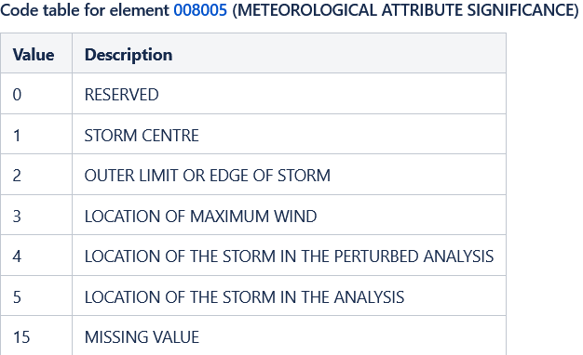
pybufrkit | decode

Slide 20
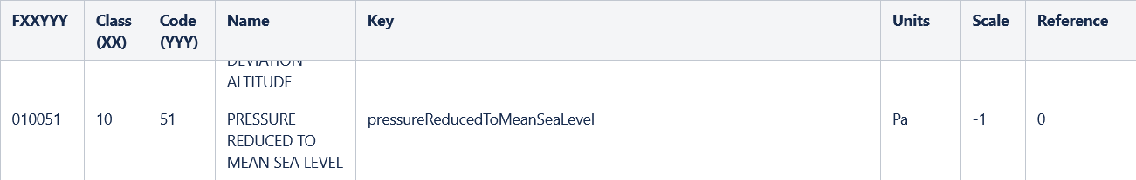
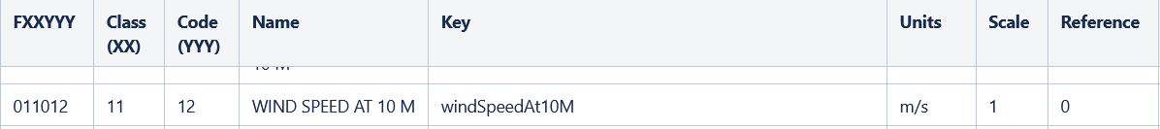
pybufrkit | decode

Slide 21
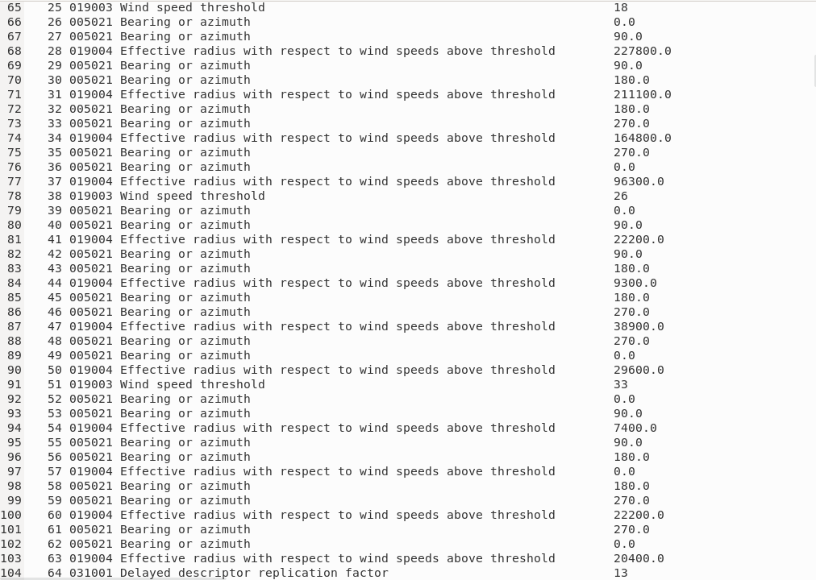
pybufrkit | decode
Radius (m) of TC winds exceeding specified thresholds for each quadrant:
18 m/s (≡ 35 knots)
26 m/s (≡ 50 knots)
33 m/s (≡ 64 knots)

Slide 22
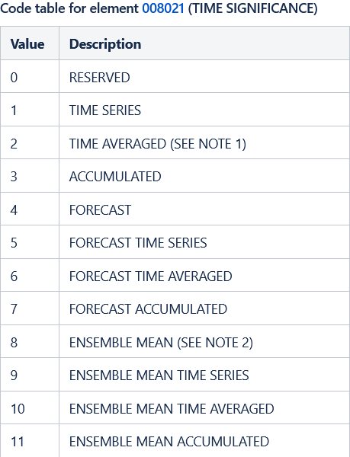
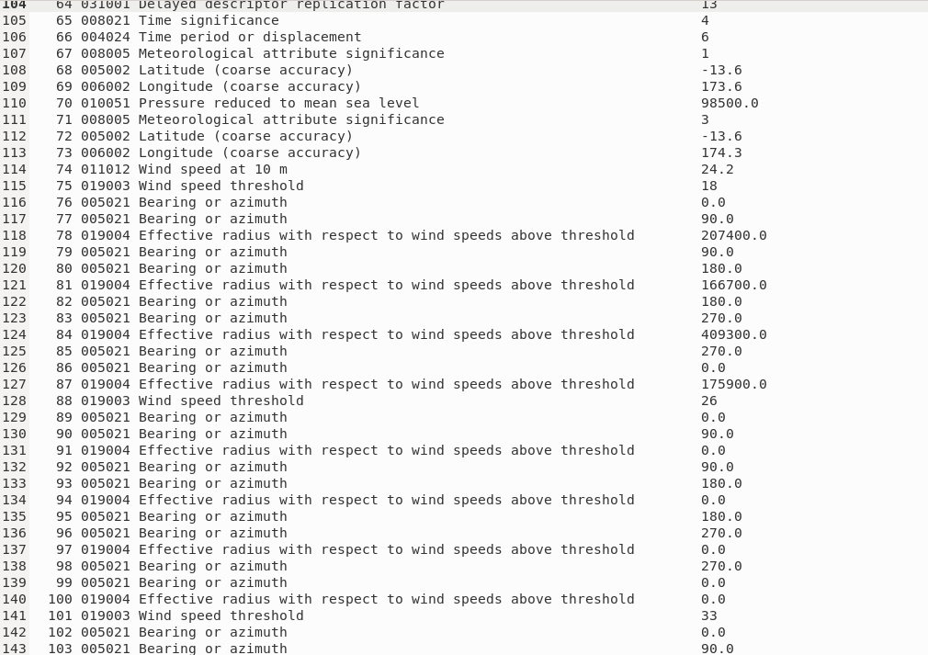
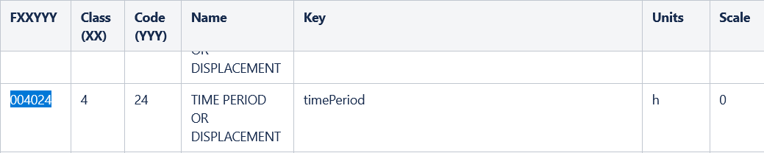
pybufrkit | decode

Slide 23
ecCodes

Slide 24
ecCodes
ecCodes is a package developed by ECMWF which provides an application programming interface and a set of tools for decoding and encoding messages in the following formats:
WMO FM-92 GRIB edition 1 and edition 2
WMO FM-94 BUFR edition 3 and edition 4
WMO GTS abbreviated header (only decoding).
A useful set of command line tools provide quick access to the messages.
C, Fortran 90 and Python interfaces provide access to the main ecCodes functionality.

Slide 25
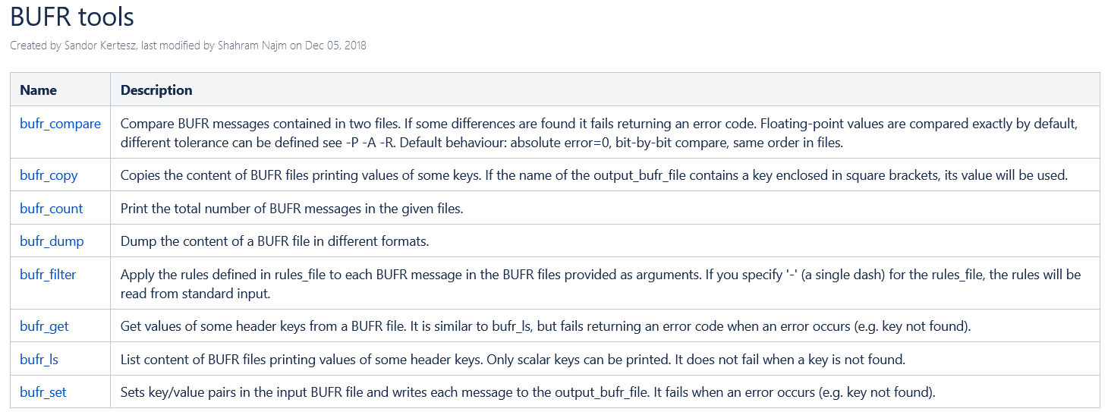
BUFR tools

Slide 26
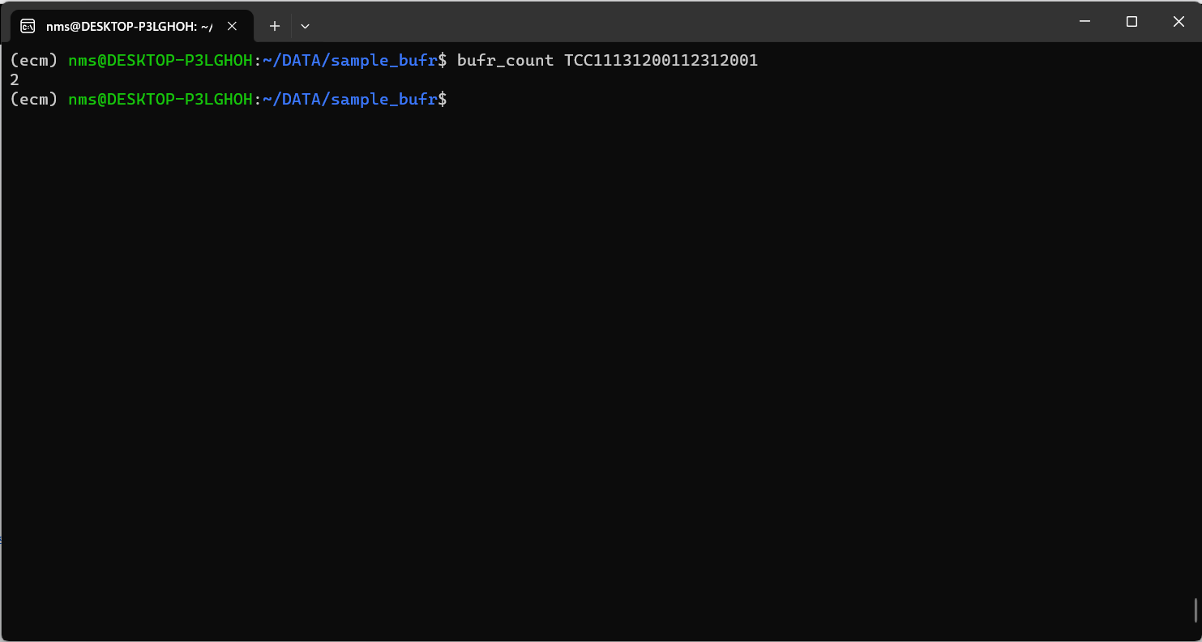
ecCodes | bufr_count

Slide 27
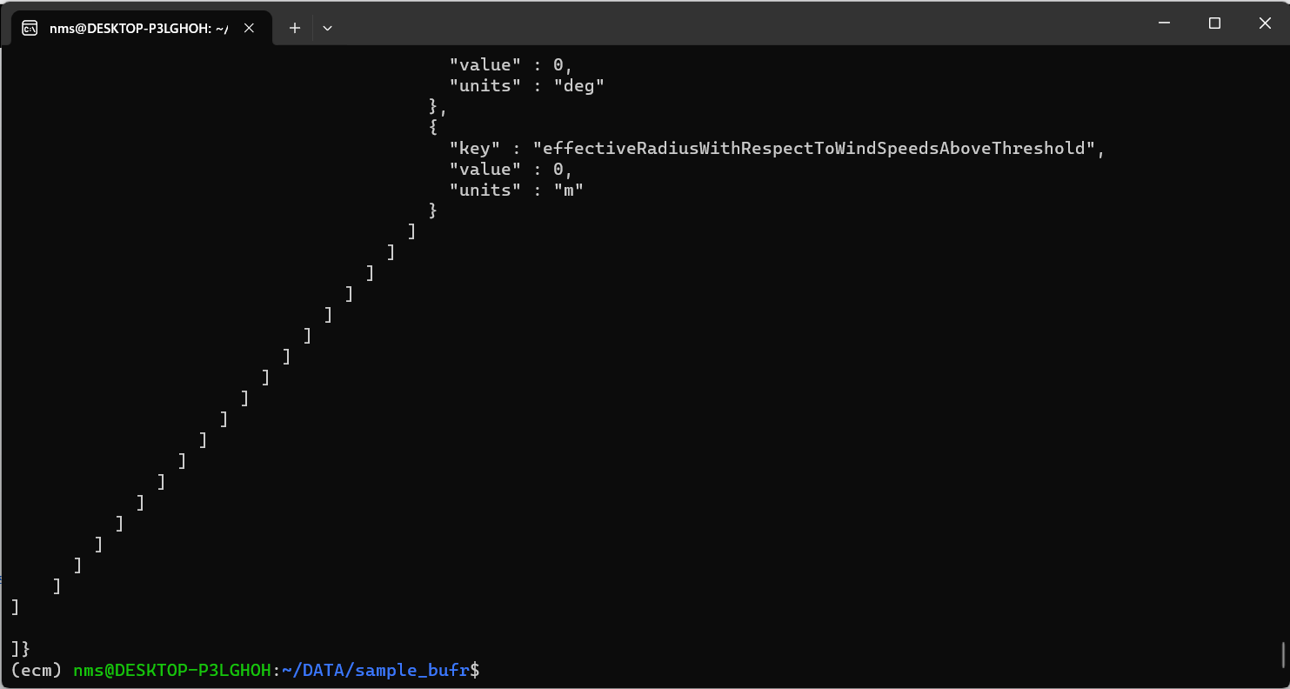
ecCodes | bufr_dump

Slide 28
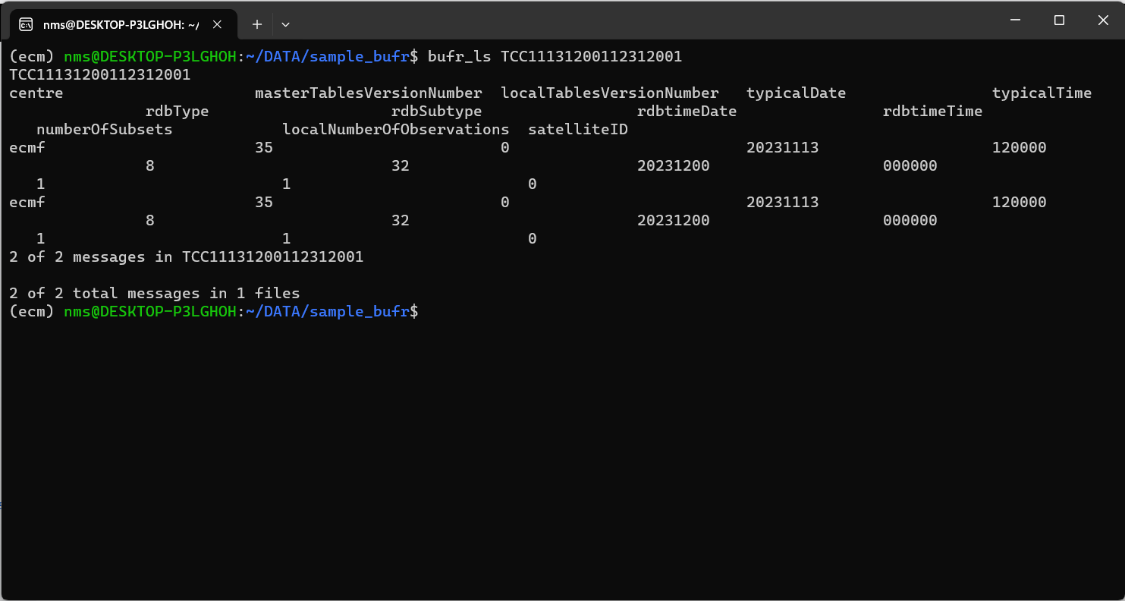
ecCodes | bufr_ls

